Slide 1
Text Mining & NLP Intros
Ted Kwartler

Slide 2


Slide 3












Ted Kwartler
MBA
Work
Teaching
Advisory Roles

Slide 4
Introductions…
Name
Location
Background
Why are you taking this course?

Slide 5
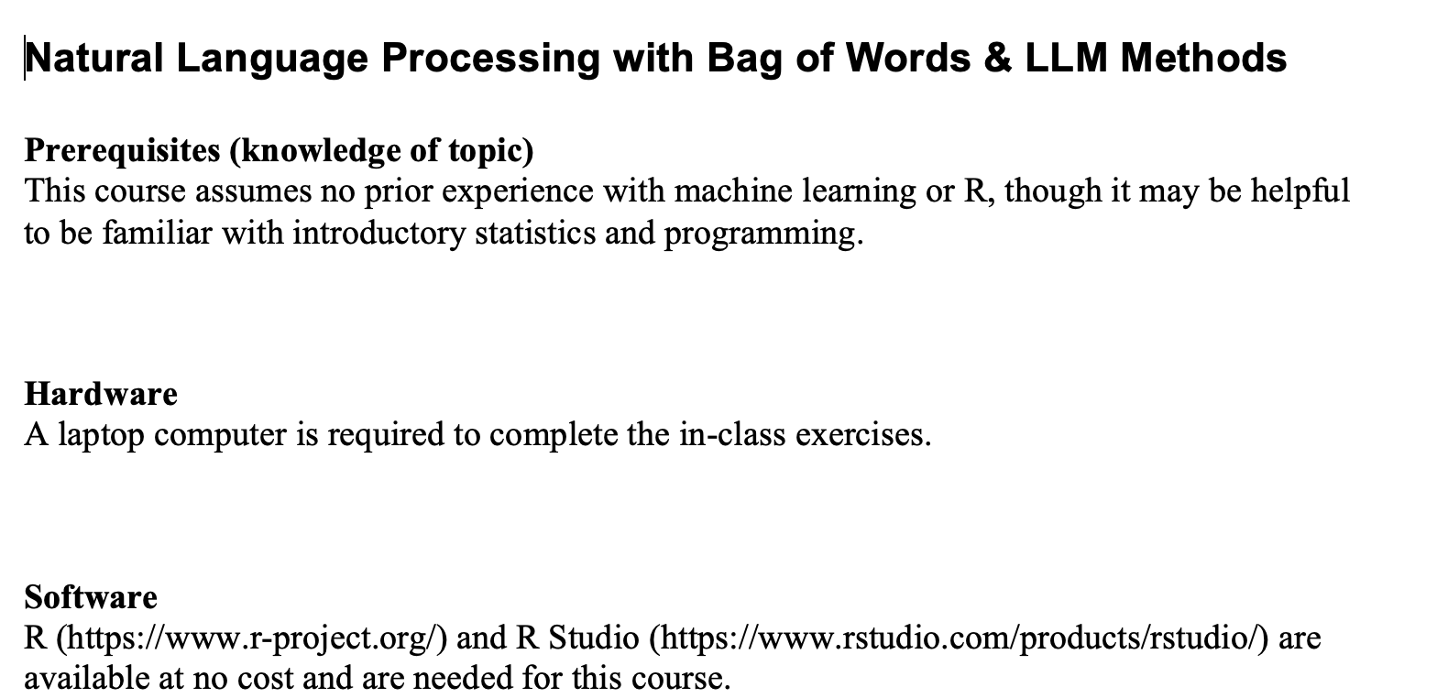
Syllabus Review

Slide 6
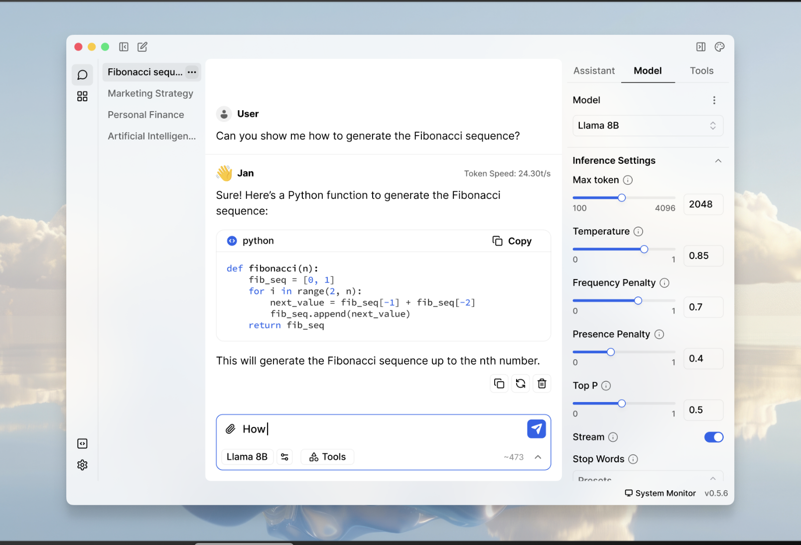
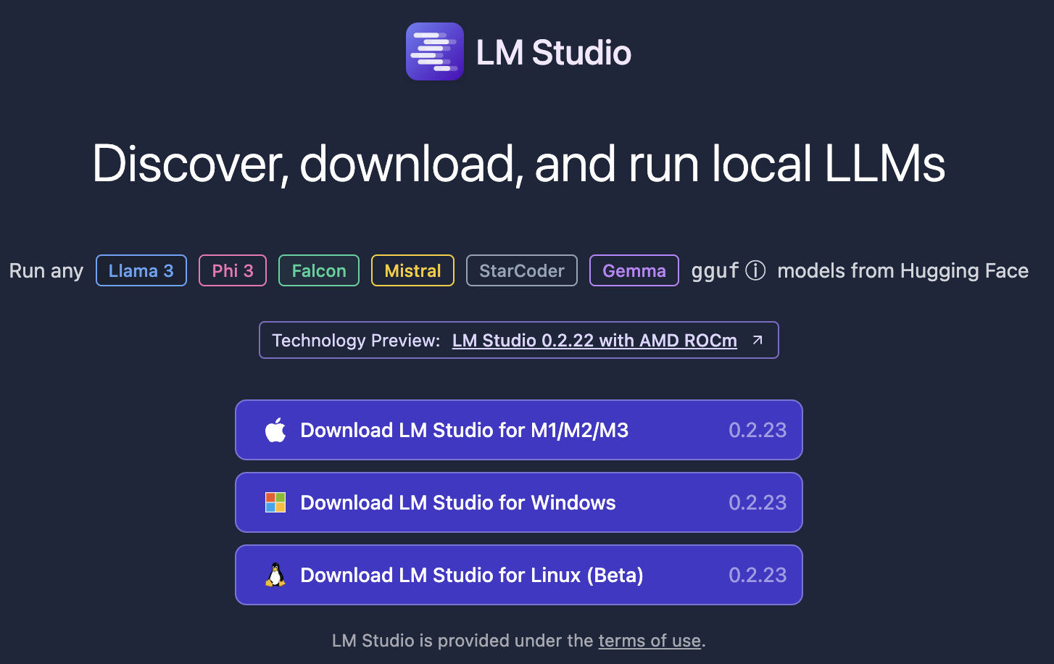
The course uses three four software components for learning.
In the next sections, skip to the method you want to use Local (Mac or Windows, Virtual Machine, Cloud/Hosted)
Integrated Development Environment
Version Control & file sharing
Statistical Software
Run local LLMs
The class will use Jan.AI, but alternatives could be LM-Studio or if you know about APIs any LLM service (openAI)

Slide 7
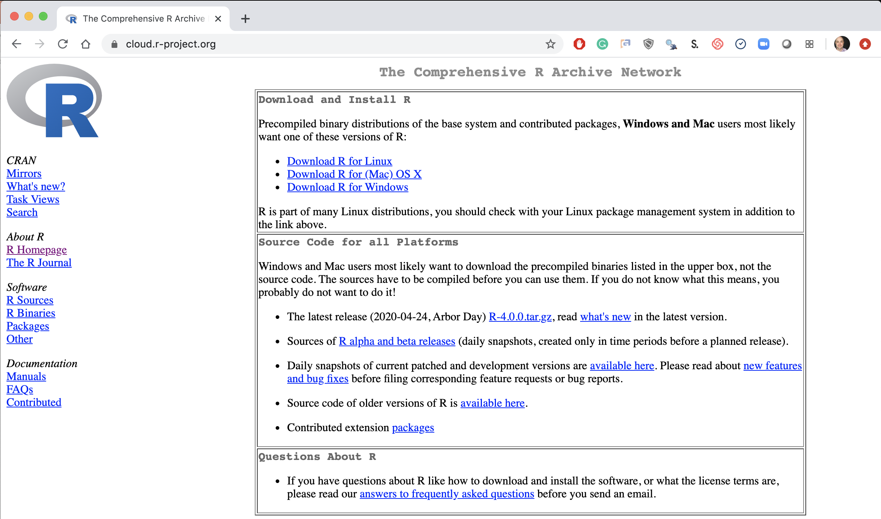
Step 1. Install Base -R
Local Laptop – Windows or Mac
Download the appropriate version Linux, Mac or Windows.
https://cloud.r-project.org/

Slide 8
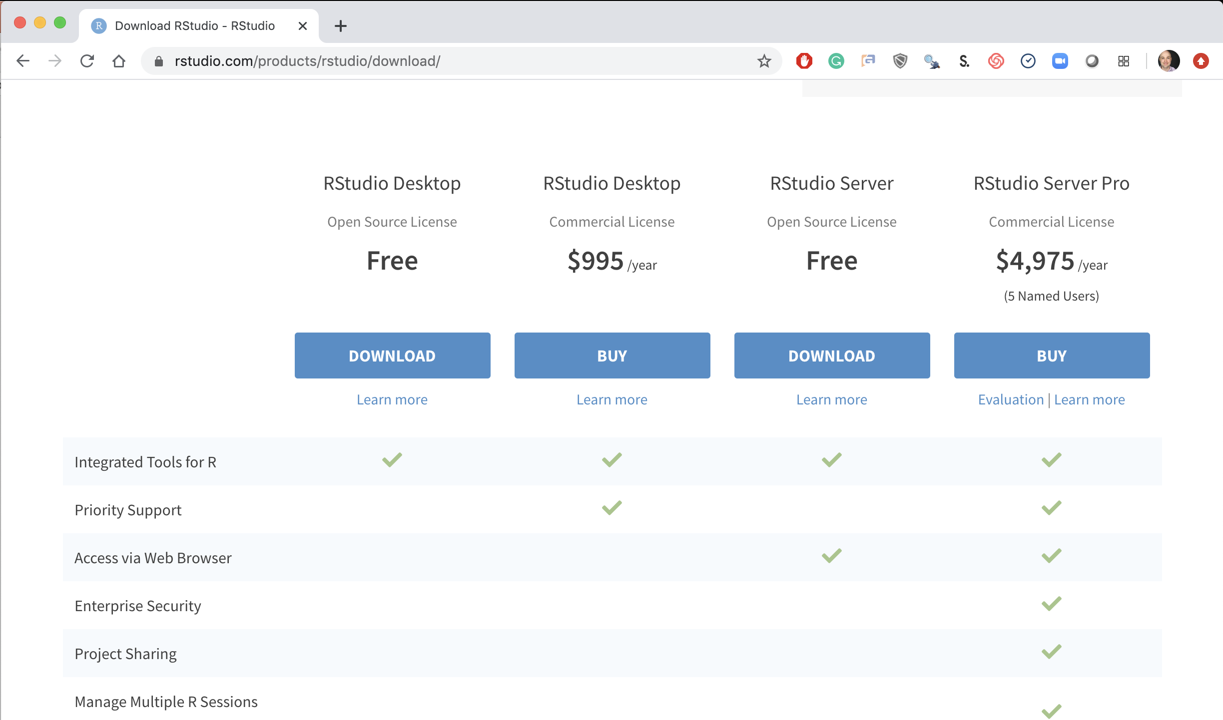
Step 2. Install R-Studio
Local Laptop Windows or Mac
Download the R Studio Desktop (Free).
https://rstudio.com/products/rstudio/download/ &
https://rstudio.com/products/rstudio/download/#download

Slide 9
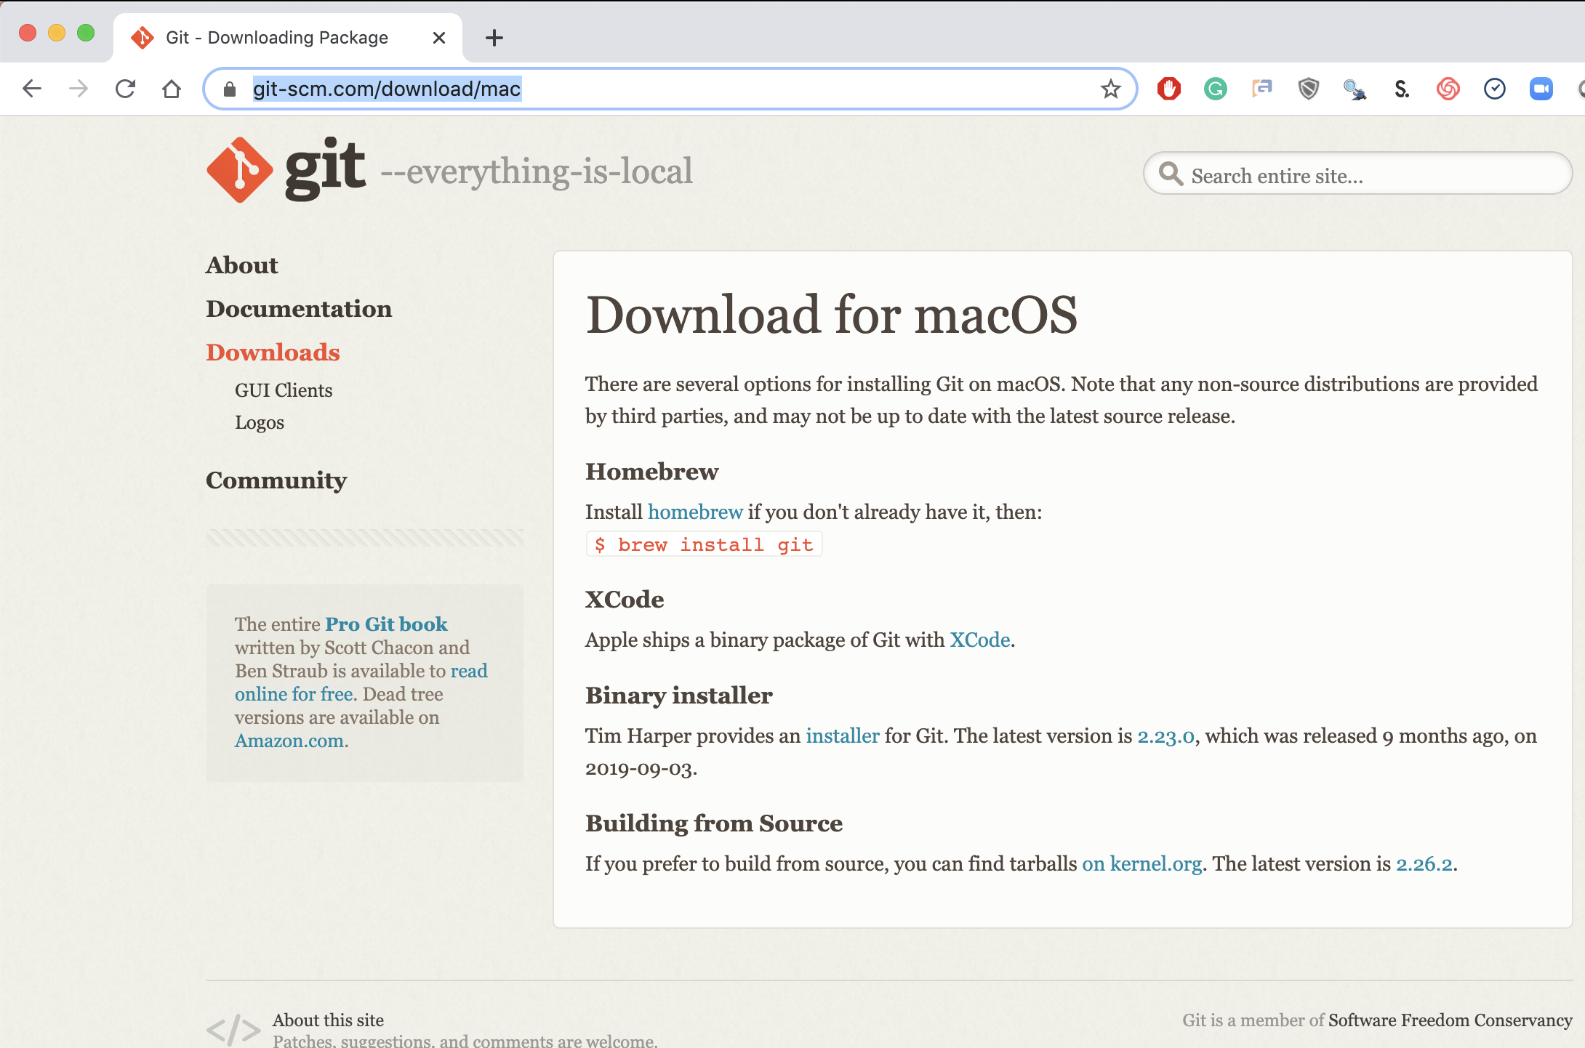
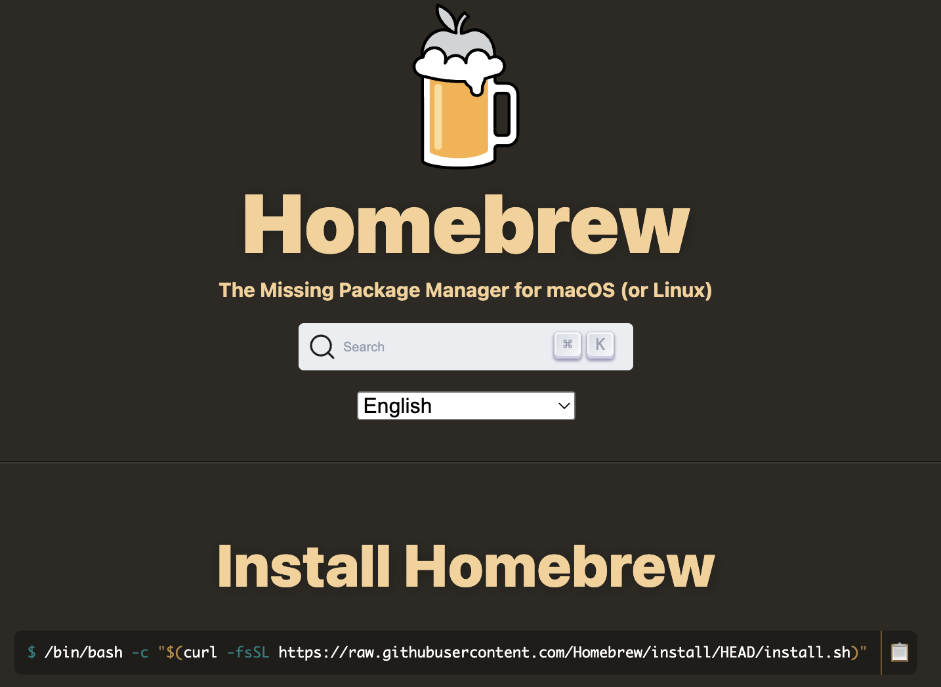
Step 3. Install Git (Mac)
Local Laptop Apple – INSTALL BREW FIRST
Download the Git Program, then follow prompts for installation.
www.brew.sh
https://git-scm.com/download/mac
https://www.youtube.com/watch?v=twFo9wCpdSU

Slide 10
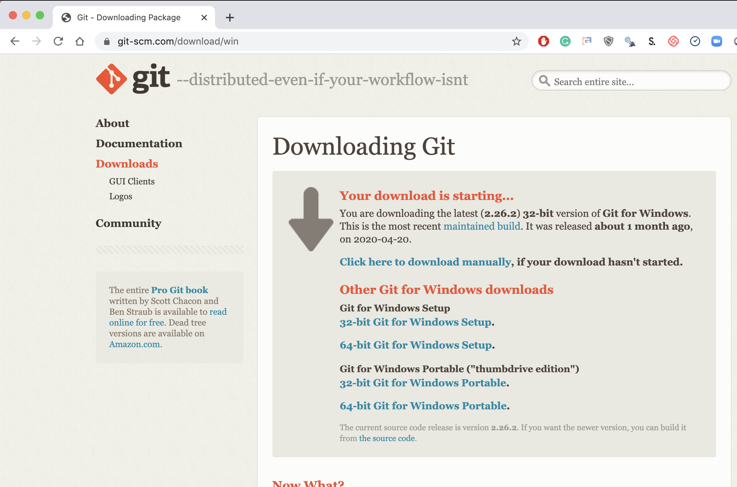
Step 3. Install Git (Windows)
Local Laptop MSFT
Download the Git Program, then follow prompts for installation.
https://git-scm.com/download/win &
https://www.youtube.com/watch?v=nbFwejIsHlY

Slide 11
Now that you have R, R-Studio & Git, time to connect to our class repository.
Connect to git repository.
R Studio sits on top of base R & adds functionality.
Class Files hosted on github.com
Makes the programmatic connection.

Slide 12
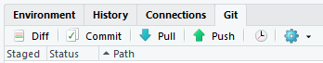
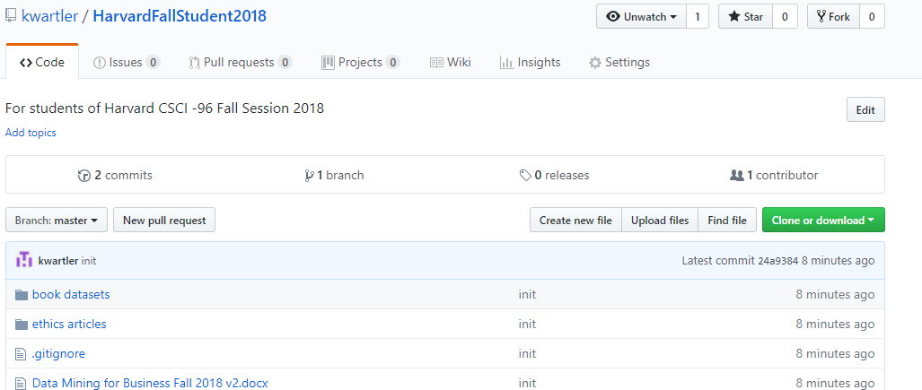
To get scripts, pptxs & data use the class repo
https://github.com/Kwartler/[insert_repo_name]
If you have git software, when do a “git pull” in Rstudio.
Alternatively you can download a zip of the repo on github.com but this can be cumbersome with file updates.

Slide 13
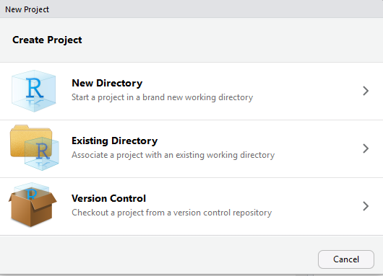
Now let’s get class files by setting up a new project & do a “git clone”
For you to look at in browser: https://github.com/kwartler
Open R Studio
File
New Project
Version Control

Slide 14
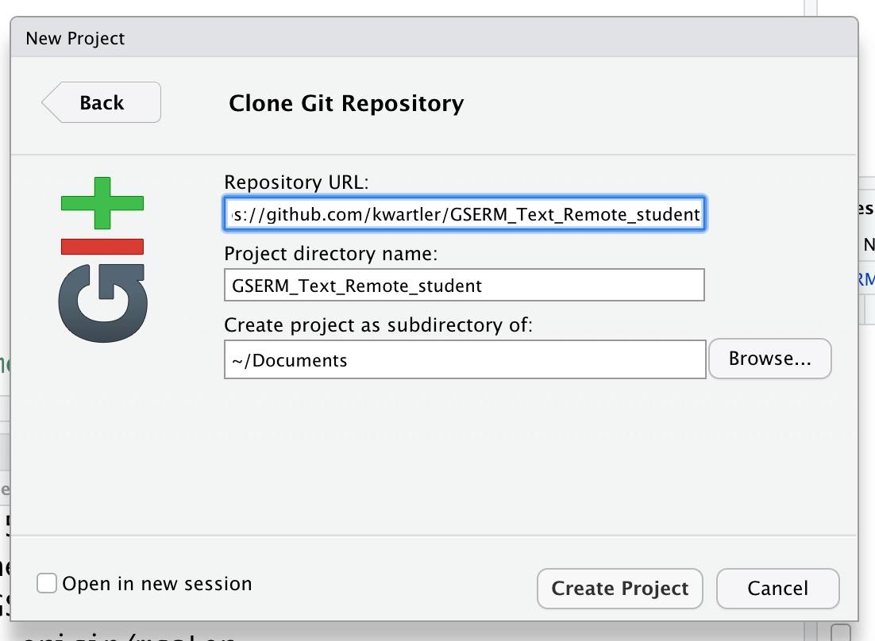
Setup a new project & do a “git pull”
In R Studio
File
New Project…
Version Control
Select Git
Add URL, folder name & destination for files

Slide 15
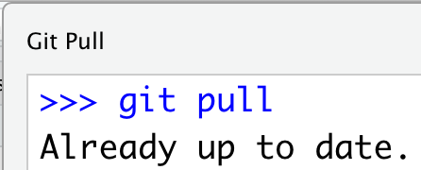
Each class we will perform a git pull in case there are updates to curriculum to aid learning.
In R Studio
File
New Project…
Version Control
Select Git
Add URL, folder name & destination for files
EACH Class session perform a Git Pull to update files

Slide 16
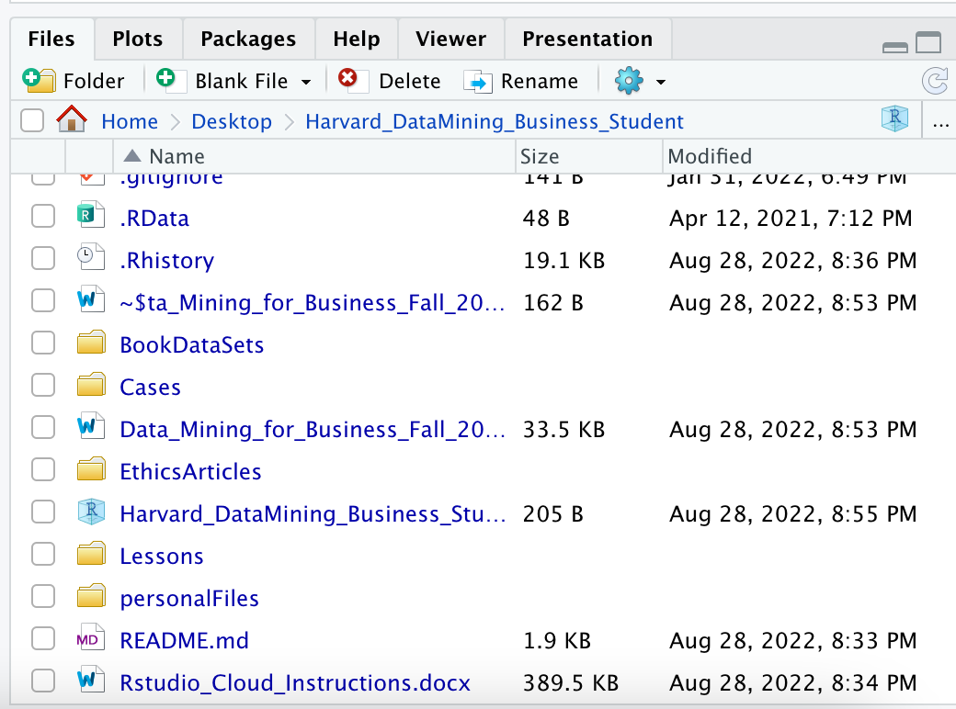
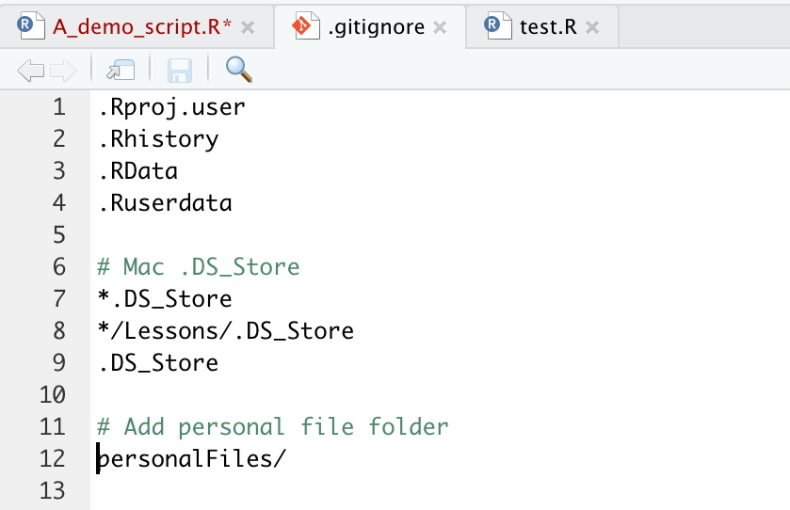
Saving YOUR copy of files.
To avoid conflicts with the class files create a “personal” folder that is ignored.
1 Create the Personal Folder
2 Add to the “gitignore” file
SAVE All your work there, copies of class files, homework, cases.

Slide 17
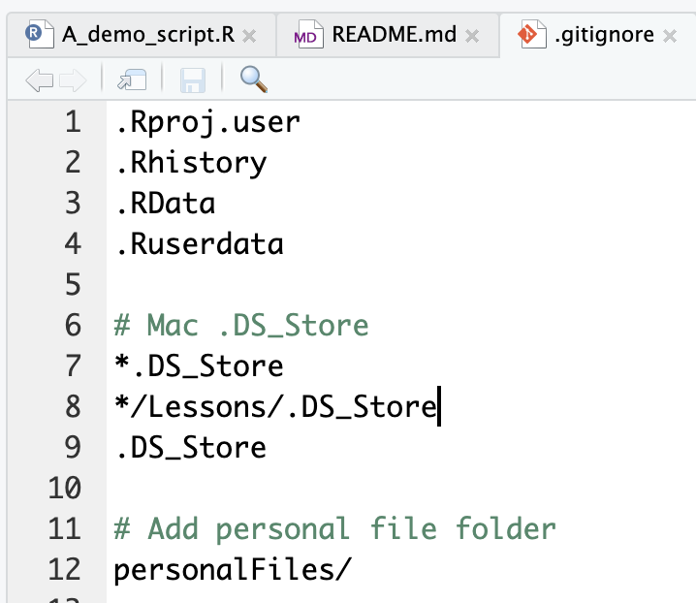
Second to last item. Create a personal folder.
Open the “gitignore” file. Add slash personal
Name of folder to be ignored “personalFiles”
When you work and make changes to scripts, SAVE AS to a personal folder that is ignored by git.

Slide 18
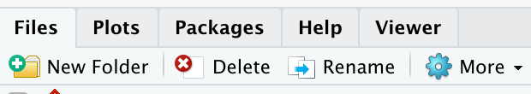
Second to last item. Create a personal folder.
In the lower right file section click “New Folder”. Name it “personal” exactly as in the gitignore (capitalization)
Click New Folder

Slide 19
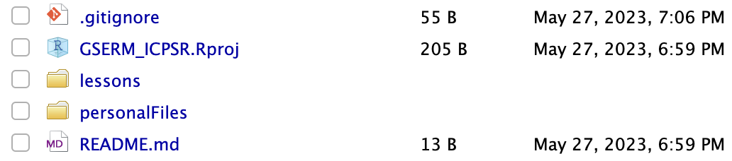
Save yourself a headache! Create a personal folder.
In the lower right file section click “New Folder”. Name it “personal” exactly as in the gitignore (capitalization)
Any file you change should be in this folder as “Save As”

Slide 20
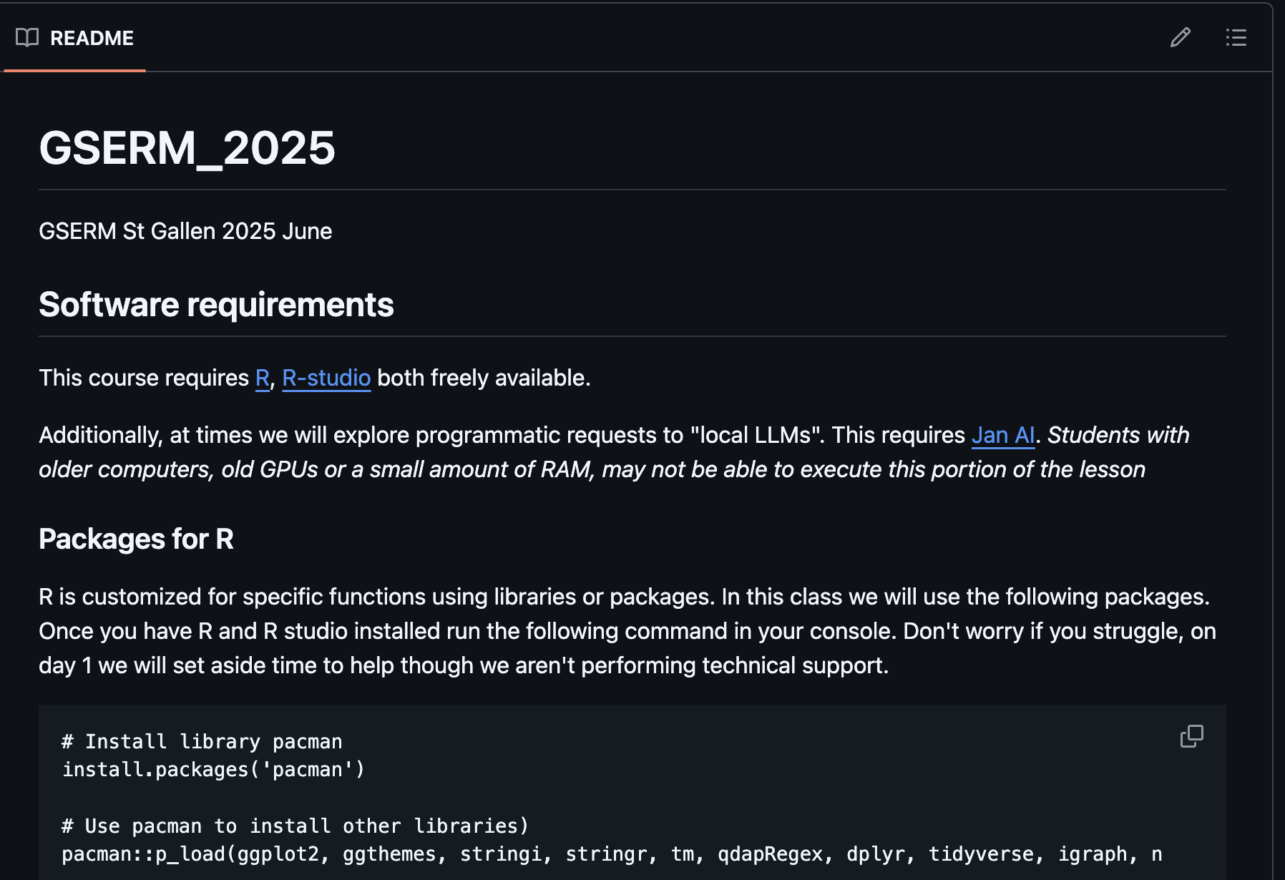
Now just run some code (we will explain it later)
https://github.com/kwartler/ class repo has the R code.
If you have R, Rstudio, Git, then made a connection and can run this code…you’re off to a great start! And don’t worry if you hit a hiccup, we will figure it out.

Slide 21
Almost setup…don’t worry if you need help!

Slide 22
The course uses three software components for learning.
Integrated Development Environment
Version Control & file sharing
Statistical Software

Slide 23

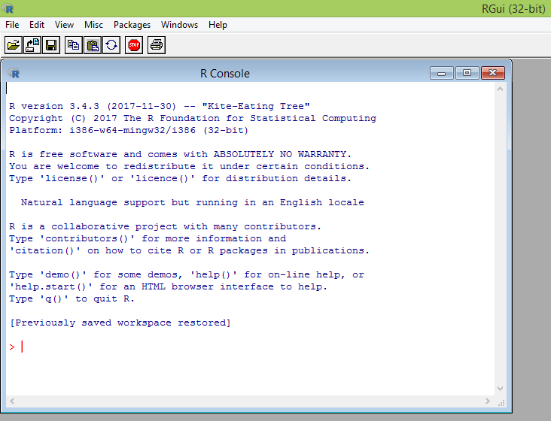
What is R?
Flexible
Open source
Academic & growing in industry
Language agnostic, SQL, Weka, C, Fortran, Java etc
R is a language & environment for statistical computing and graphics. It is the most popular statistical software in circulation today and is used by more than 2 million data scientists & statisticians worldwide.
How Companies Use R to Compete in a Data-Driven World, Data-informed.com

Slide 24

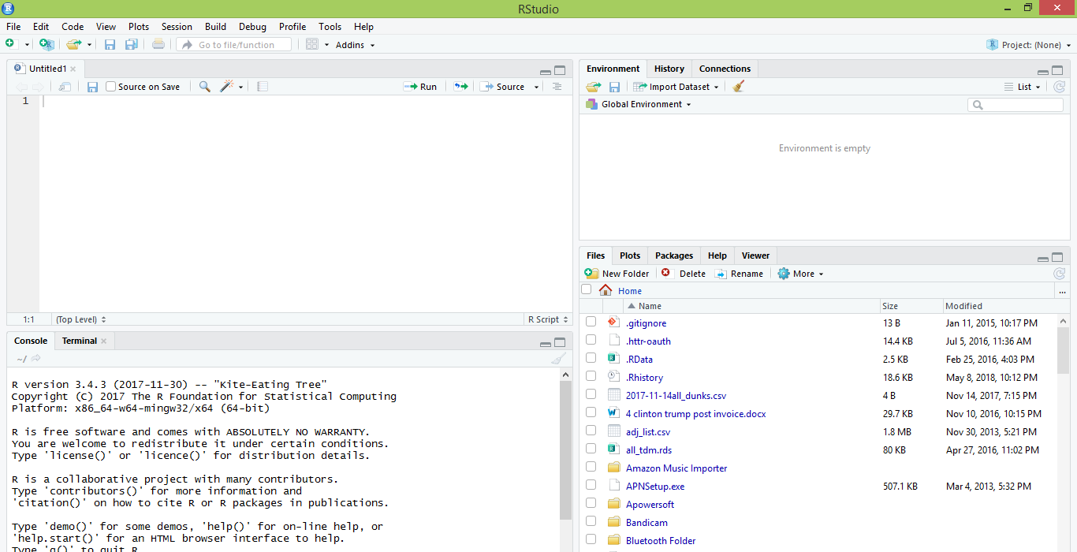
What is R Studio?
IDE – Integrated Development Environment
Adds additional functionality e.g. git, shiny projects, markdown templates
R studio is the most popular IDE for R although there are others & you don’t actually need it to execute R code.

Slide 25
What is the relationship between R & R studio?
Nice interface & additional functionality for faster programming, analysis & production.
Statistical & graphing software
R Studio sits atop of the installed R version. Without base R, R studio cannot function. By programmatically accessing base R, R Studio improves the interface and functionality.

Slide 26
Now that you have R, R-Studio & Git, time to connect to our class repository.
Connect to git repository.
R Studio sits on top of base R & adds functionality.
Class Files hosted on github.com
Makes the programmatic connection.

Slide 27
R Studio has four main panes
Scripting
Environment
Commands are written & adjusted here then executed in the console. Then saved for future quick execution.
List of objects & values
e.g. loaded “excel” files
Files, Plots, Packages, Help
Console
Find files, load packages, see visualizations and quickly find help
Execution of scripts and commands, data exploration and code results
R Studio works on Linux, Windows and iOS.

Slide 28
R: Where is it being used?
Media
Google
Facebook
Twitter
Foursquare
Kickstarter
New York Times
Economist
Warner Bros.
Services
Zillow
Trulia
eHarmony
DataSong
PredictWise
Nationwide
Finance
Lloyd’s Bank
Credit Suisse
American Century
Australia and New Zealand Banking Group
Technology
SAS
Oracle
IBM
Teradata
Coursera
SAP
DataCamp
Alteryx
TIBCO
OneTick
Amazon
Google
Microsoft
U.S Government
Food & Drug
Administration
National Weather
Service
National Institute
of Standards
in Technology
R is ubiquitous in various industries used for analysis, prototyping and visualization. However, more often python is used in production environments.

Slide 29
Ok, it’s awesome but…
Pros
Cons
VERY extensible
15K+ packages
Built by stats, made for stats
Free, open source
Cutting edge
Diverse applications
Outstanding graphical capabilities
Large community-based help
Tough to do “big data”
In memory data constraints w/o extra effort
Official documentation is terse
Not as polished as a commercial application
Slow compared to lower level languages
Production worthy apps can be difficult to create
Large community-based help
Most Large Language Models (LLMs) like ChatGPT know R code! You can just ask to get help.

Slide 30

A basic R workflow
Let’s eat a banana for breakfast. Where is the fruit?
If a “local” file define the path to the file
OR WINDOWS
scenesDF <- "C:\\Documents\\hult\\ forceAwakens_definedScenes.csv"
OR MAC
scenesDF <- "~/Desktop/Hult/forceAwakens_definedScenes.csv"
OR
From a URL
scenesDF <- 'https://raw.githubusercontent.com/kwartler/Hult_Visualizing_Analyzing_Data_with_R/main/Lessons/A_Intro_Admin/data/forceAwakens_definedScenes.csv'
The item of interest needs to be in the “working directory” or a defined path

Slide 31


R uses functions, libraries & objects
Found the fruit basket! What tools do I need?
# Load Libraries
library(knife)
library(peel)
library(readr)
Change R into a breakfast preparing machine with specialized libraries.

Slide 32

Another trap!
Before loading a library use
install.packages(“name of package”).
You only need to do this once per environment
But you will need to repeat it w/each new environment!

Slide 33

R uses functions, libraries & objects
Now R is a cutting & peeling machine, let’s pick our fruit.
library(knife)
library(peel)
banana <- read.csv(“Banana.csv”)
OR
banana <- read.csv(www.csvFile.csv)
Must
Be In the working directory or full path declared
Be inside quotes
Have correct capitalization, spacing & spelling matter.
Must
Refer to the URL
Or be the URL in quotes
R now has the object called banana in memory ie “opening a spreadsheet”

Slide 34

What if my file is Excel or ???
R can open many files types with different functions
CSV
Excel
SaS
SPSS
Rds, rda, fst etc
Connections
Databases (SQL, mongoDB)
S3 Buckets
APIs
Recommendation: to get started stick with CSV. Most software can export CSV. Most class files are CSV.

Slide 35
R uses functions, libraries & objects
Function
Input
Output
R uses predefined functions to accomplish things.

Slide 36
R uses functions, libraries & objects
Our Function accepts any number and is a “plus 2 and multiply by 3” Machine.

Slide 37
R uses functions, libraries & objects
plusTwoTimesThree
Input
X = 2

Slide 38
R uses functions, libraries & objects
plusTwoTimesThree
X = 2
2+X = 4
4 * 3 = 12
Return (12)
Input
X = 2

Slide 39
R uses functions, libraries & objects
plusTwoTimesThree
X = 2
2+X = 4
4 * 3 = 12
Return (12)
Input
X = 2
Output
12

Slide 40
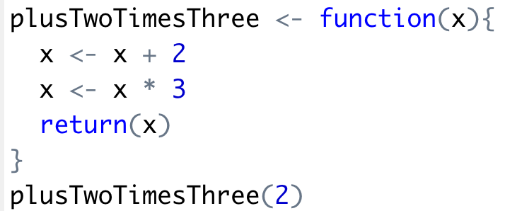
R uses functions, libraries & objects
Input
X = 2
Output
12

Slide 41
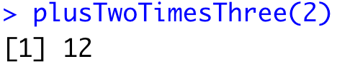
R uses functions, libraries & objects
Input
X = 2

Slide 42

R uses functions, libraries & objects
halfBanana <- cutinhalf(banana )
Output
Function
(
Input
)
“ <- ” is the assignment operator

Slide 43


R uses functions, libraries & objects
library(knife)
library(peel)
banana <- read.csv(“Banana.csv”)
halfBanana <- cutinhalf(banana )
halfBanana <- peel ( halfBanana)
Output
Function
(
Input
)
Results of an object can be used in the next function.

Slide 44
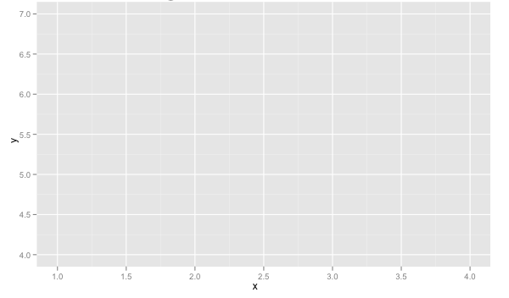
R uses functions, libraries & objects
setwd(“ted/fruit/basket”)
library(knife)
banana <- read.csv(“Banana.csv”)
halfBanana <- cutinhalf(banana)
halfBanana <- peel(halfBanana)
plot(halfBanana)
Function
(
Input
)
You don’t always have to declare an output object & you can also save items to disk.

Slide 45
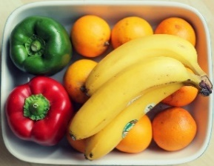





Workflow review
1
Use file paths to point to your files & where to save outputs.
2
Load some customized libraries with library() for your specific analysis and methodology. Sometimes we will also create customized functions not in a library to aid our analysis.
3
Read in the file so the object is “in-memory” with read.csv() or similar.
4
Apply a function(s) from a library to adjust or create new objects in memory. The pseudo code for this is:
object<-function(applied to object)
5
Consume the results by saving, plotting etc.

Slide 46
On to more interesting stuff!

Slide 47


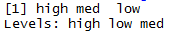
As you just saw R has many data types.
Numeric/Integer
Factors (Distinct Classes)
as.factor(c('MALE','FEMALE','FEMALE'))
1
10
12
3.47
82
MALE
FEMALE
FEMALE
Unordered
Cardinality
2
c(1,10,12,3.47)
[1] MALE FEMALE FEMALE
Levels: FEMALE MALE
High
Med
Low
Ordinal
as.factor(c(‘High',‘Med',‘Low'))
Cardinality
3
Boolean
STRING (just text)
c('MALE','FEMALE','FEMALE')
TRUE
TRUE
FALSE
TRUE
FALSE
c(T, T, F, T, F)
c(TRUE,TRUE, FALSE, TRUE,FALSE)
c(T,TRUE, F, TRUE,FALSE)
[1] "MALE" "FEMALE" "FEMALE"
In R, a vector can be numeric, Boolean (T/F), factors, or contain strings.

Slide 48
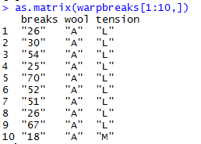
More Complex Common R Object Types - Matrix
Matrices are 2 dimensional data (rows/columns). Each column must be the same type.
RowID | breaks | wool | tension
1 | 26 | A | L
2 | 30 | A | L
3 | 54 | A | L
4 | 25 | A | L
5 | 70 | A | L
6 | 52 | A | L
7 | 51 | A | L
8 | 26 | A | L
9 | 67 | A | L
10 | 18 | A | M
All strings
Matrices are organized into rows & columns. Row names are not actually a vector of the matrix but are an attribute of the matrix. In excel you would need a standalone vector to capture that information.

Slide 49
More Complex Common R Object Types – List
Lists are multi-dimensional objects that can contain different data types of different lengths.
ListA
single value
Single data frame or matrix
single vector
Nested list
Nested data frame
Nested matrix
Lists are useful for data organization but can be complex and difficult to navigate to get specific information.

Slide 50
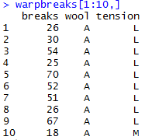
More Complex Common R Object Types – Data Frame
Data Frames are like 2 dimensional data objects but can have mixed data types.
A data frame is actually a named list but with equal length elements. Being a list lets it contain mixed data types.
RowID | breaks | wool | tension
1 | 26 | A | L
2 | 30 | A | L
3 | 54 | A | L
4 | 25 | A | L
5 | 70 | A | L
6 | 52 | A | L
7 | 51 | A | L
8 | 26 | A | L
9 | 67 | A | L
10 | 18 | A | M
Integers
Factor
Factor
Unlike a matrix, DFs can hold different types of vectors

Slide 51
When should you use a specific data type?
Number of Dimensions >1
No
Yes
Use a Vector
Data Types >1
No
Yes
Matrix or Array
Data Frame or List
Most analyses start with a data frame, and change classes as needed.

Slide 52
Let’s get into some code!
Open up
﻿A_Basic_Test_Drive.R

Slide 53
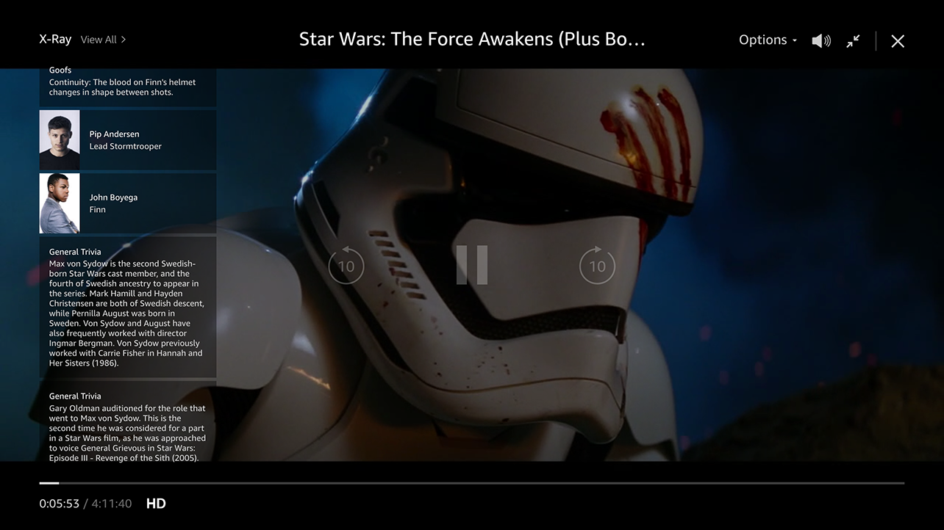
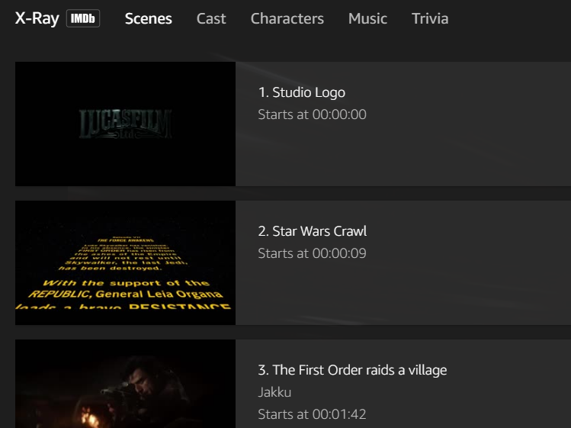
Amazon X-Ray: Movie Meta Data
Left Hand Screen:
Actor Information & Trivia
Center “Pop-over” Screen:
Scenes, Cast, Characters, Music & Trivia

Slide 54
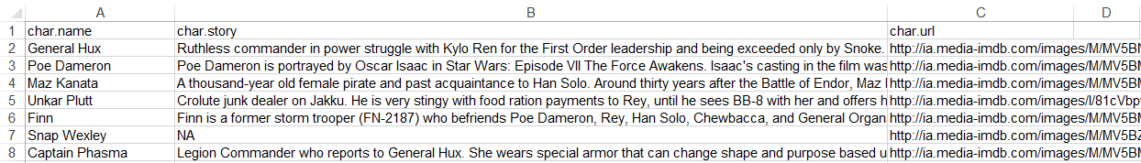
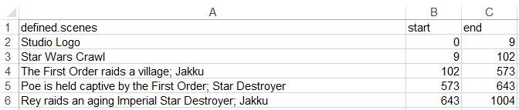
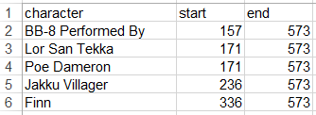
Let’s explore Amazon’s x-ray feature
Character Background
Official Scenes
Character Appearances

Slide 55

Let’s practice! Open B_demo_script.R
Learning Outcome: Following a consistent workflow, load, clean, & analyze real data with multiple data types to establish basic familiarity.
Your choice!

Slide 56
Do or Do Not There is No Try…

Slide 57

ggplot2 is the grammar of graphics
ggplot(plotDF, aes(colour = name))
Layers are declared and added in sequence to construct a visual.

Slide 58
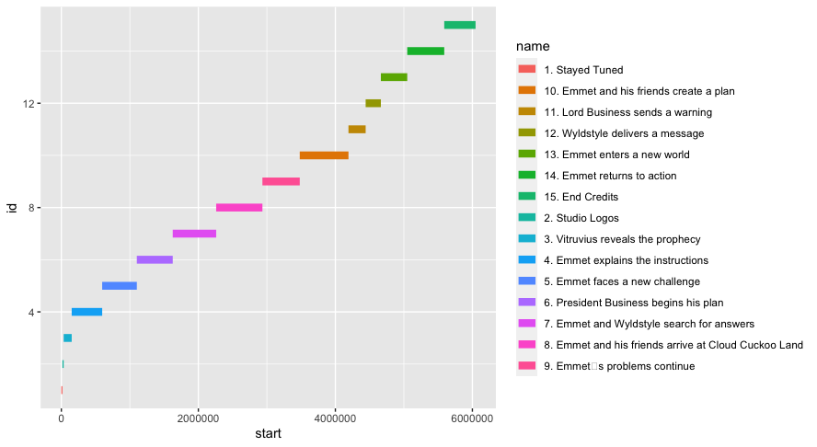
ggplot2: adding a layer
ggplot(plotDF, aes(colour = name)) +
geom_segment(aes(x = start, xend = end,
y = id, yend = id), linewidth = 3

Slide 59
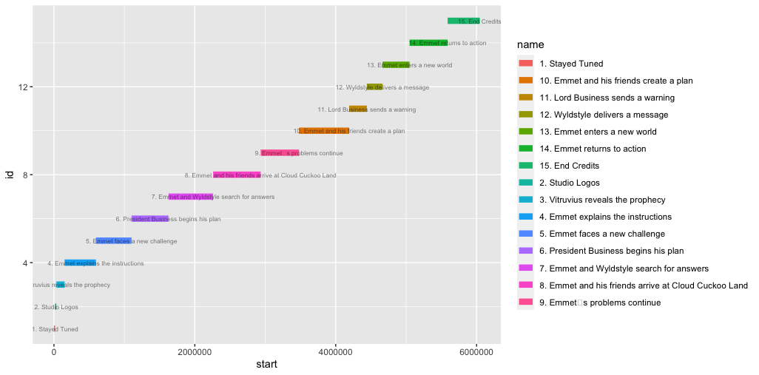
ggplot2: adding a layer of text
ggplot(plotDF, aes(colour = name)) +
geom_segment(aes(x = start, xend = end,
y = id, yend = id), linewidth = 3) +
geom_text(data=plotDF, aes(x = end, y = id, label = name),
size = 2.25, color = 'black', alpha = 0.5, check_overlap = TRUE) +

Slide 60
gpplot2: Adding an aesthetics layer
ggplot(plotDF, aes(colour = name)) +
geom_segment(aes(x = start, xend = end,
y = id, yend = id), linewidth = 3) +
geom_text(data=plotDF, aes(x = end, y = id, label = name),
size = 2.25, color = 'black', alpha = 0.5, check_overlap = TRUE) +
theme_gdocs() + theme(legend.position = "none") +
ggtitle(movieTitle)

Slide 61
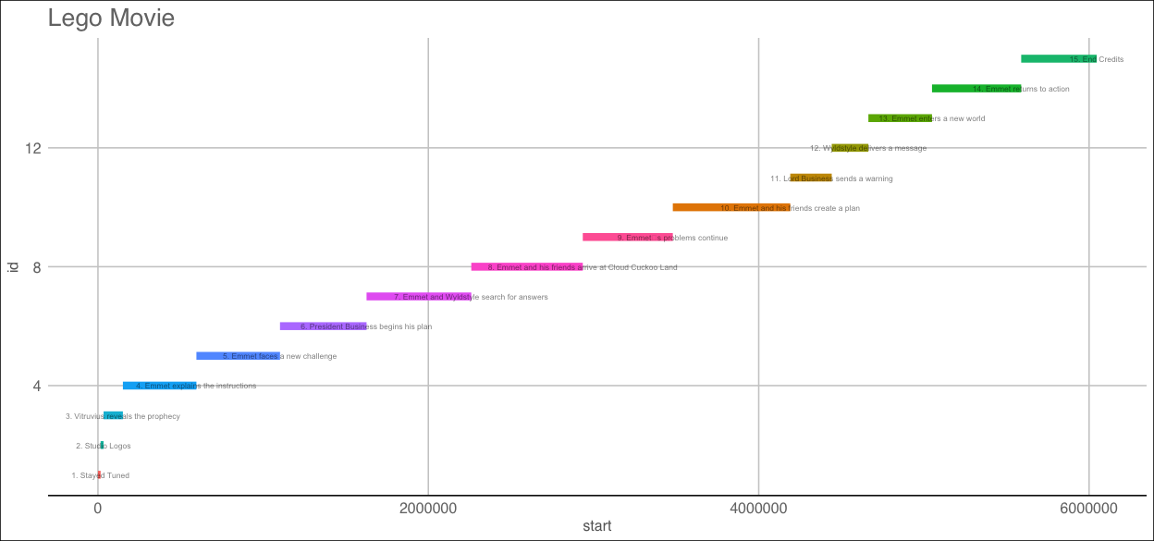

Slide 62


Slide 63
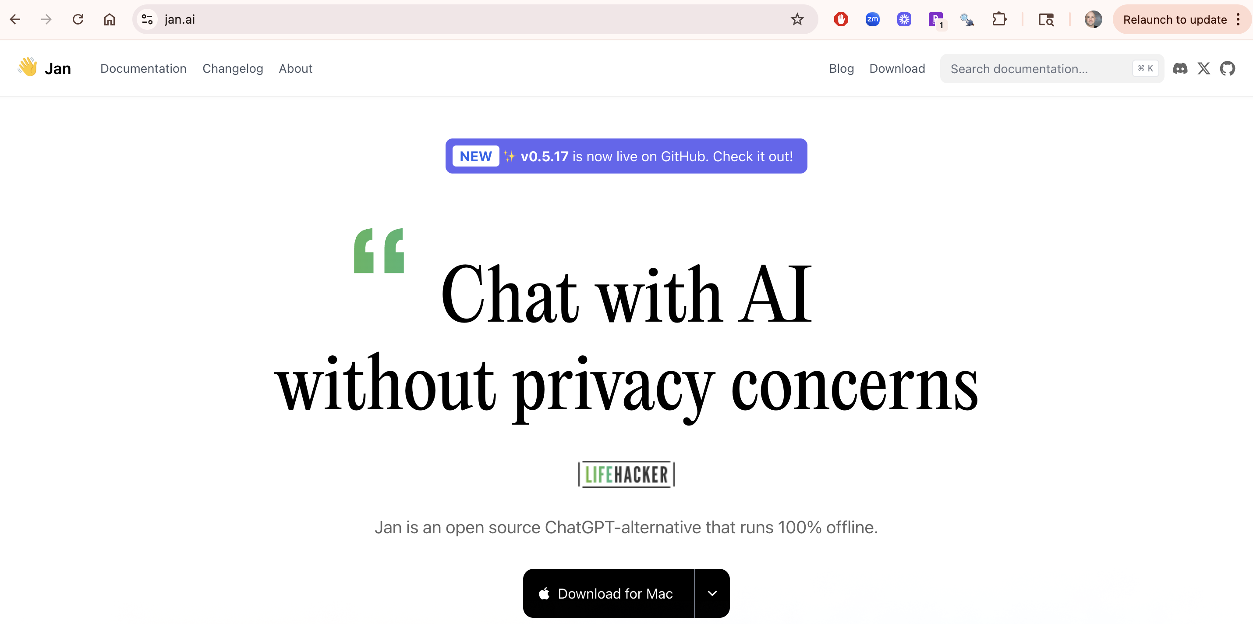
Now let’s install a local LLM for later use
Select your operating system and install Jan AI

Slide 64
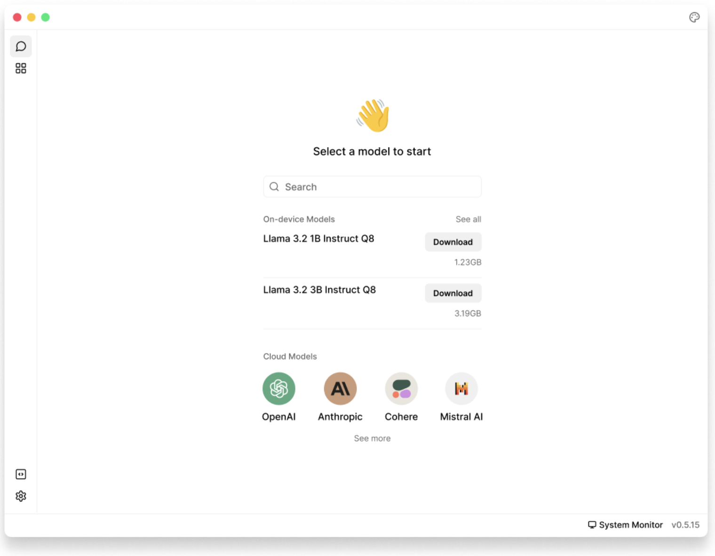
https://jan.ai/docs/quickstart
You need to install a model. Within Jan AI you can also add paid service API keys but for now install Llama 3.2 1B Instruct Q8*
*We will explain the basics of this in a later lesson.

Slide 65
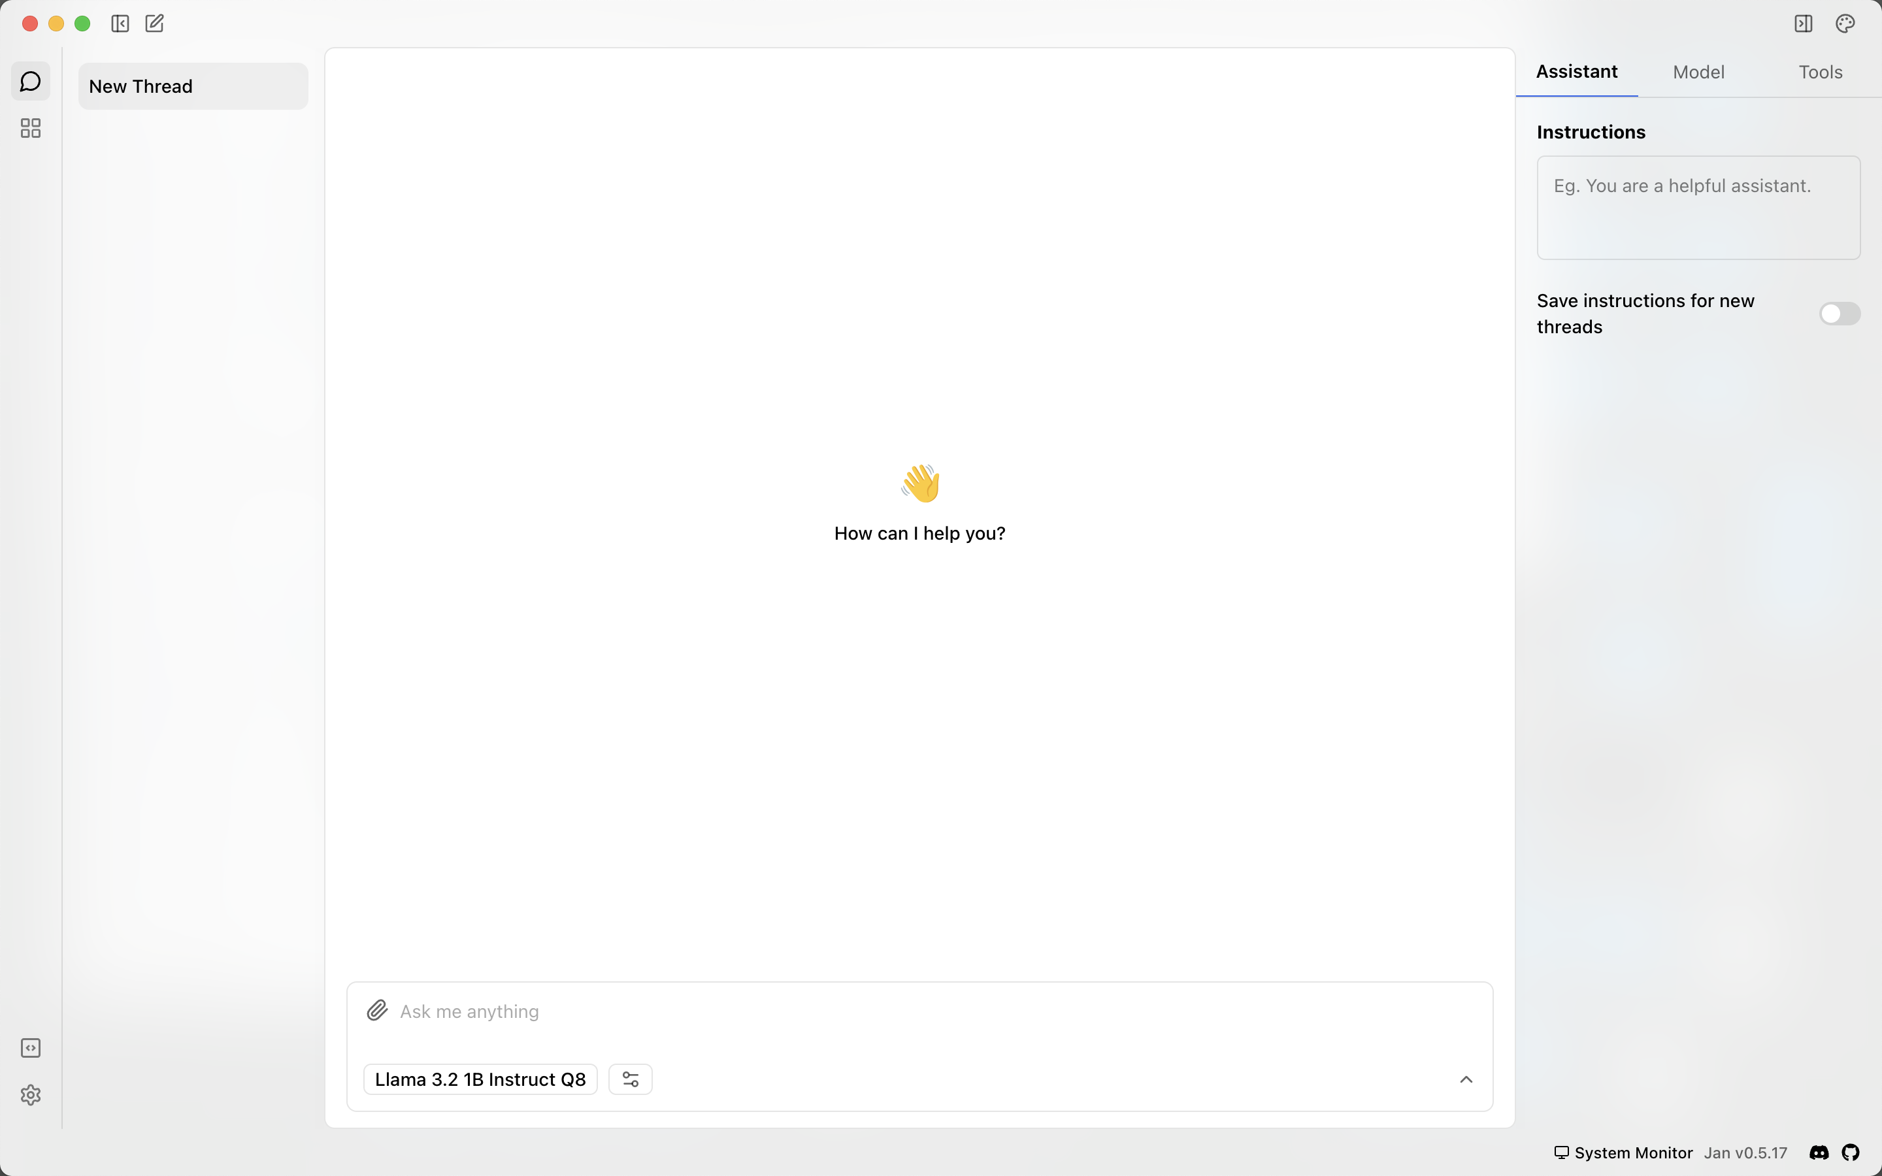
Once installed & downloaded it should look like this.

Slide 66
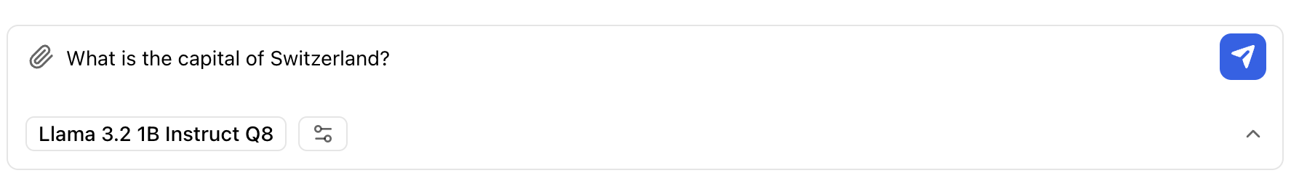
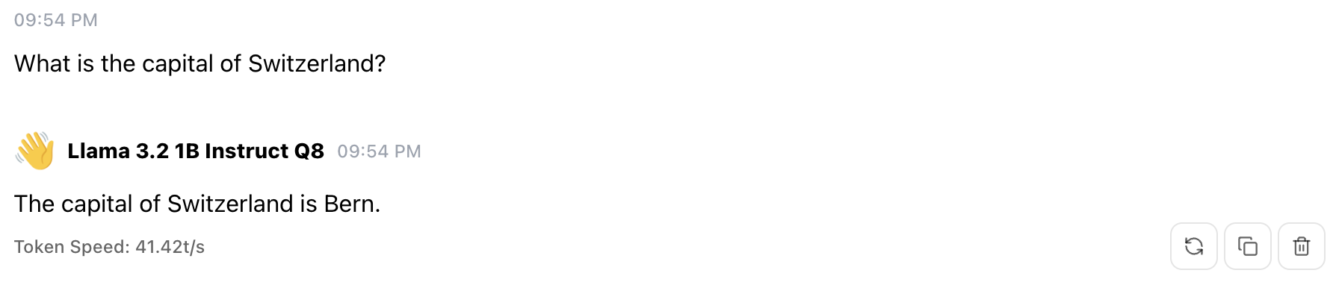
Ask a simple question [it’s a simple model]
The first chat will take a moment to load the LLM

